Slide 1
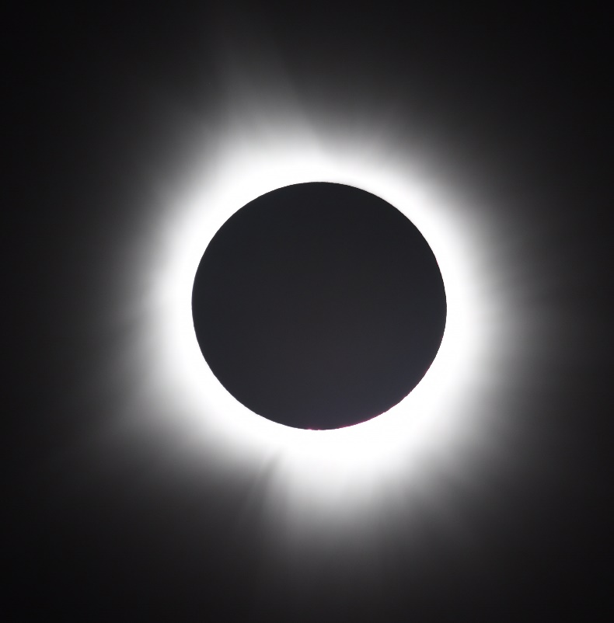
Lecture 04 BLE Advertisement Deep Dive
Credit: Andy Mauragis
CS397/497 – Wireless Protocols for IoT
Branden Ghena – Spring 2024
Materials in collaboration with Pat Pannuto (UCSD) and Brad Campbell (UVA)

Slide 2
Announcements
Hardware for labs
I have some! I’ll pass out more after class today
Everyone needs their own board and USB cable
I’ll record which board is going to which student
You’ll have to return them before the end of the quarter or else
Each group will end up with three among them
I’ll do the pairing for remaining groups later today
Wireshark lab due tonight!!
BLE lab will be up tomorrow. Delayed a little by the eclipse

Slide 3
Today’s Goals
Describe BLE advertising and scanning roles
Deep dive into advertisements. Questions we might ask as researchers.
What are the real-world use cases of advertisements?
How much energy do advertisements take?
What is the probability of receiving a packet?
What is the probability of receiving data?

Slide 4
Outline
BLE Layers
Physical Layer
Link Layer
BLE roles
Advertising
Scanning
Communicating with advertisements
Advertisement Use Cases
Energy Use
Packet Collisions
Scan Responses

Slide 5
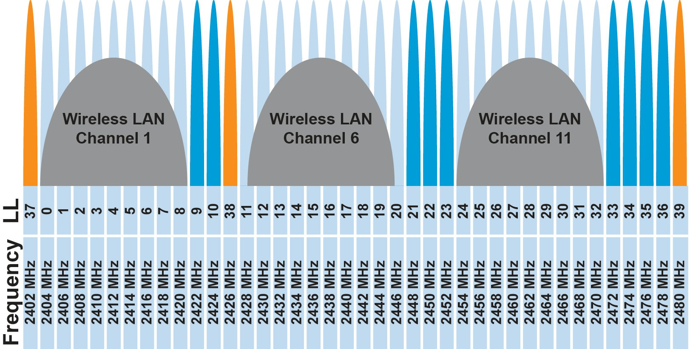
BLE frequency
2.4 GHz carrier, Forty 2-MHz channels, 1 Mbps data rate
37, 38, 39 for advertising
0-36 for connection (FHSS)
Why doesn’t BLE avoid WiFi altogether?

Slide 6
BLE frequency
2.4 GHz carrier, Forty 2-MHz channels, 1 Mbps data rate
37, 38, 39 for advertising
0-36 for connection (FHSS)
Why doesn’t BLE avoid WiFi altogether?
Can’t on 2.4 GHz
Wants 2.4 GHz for technology improvements

Slide 7
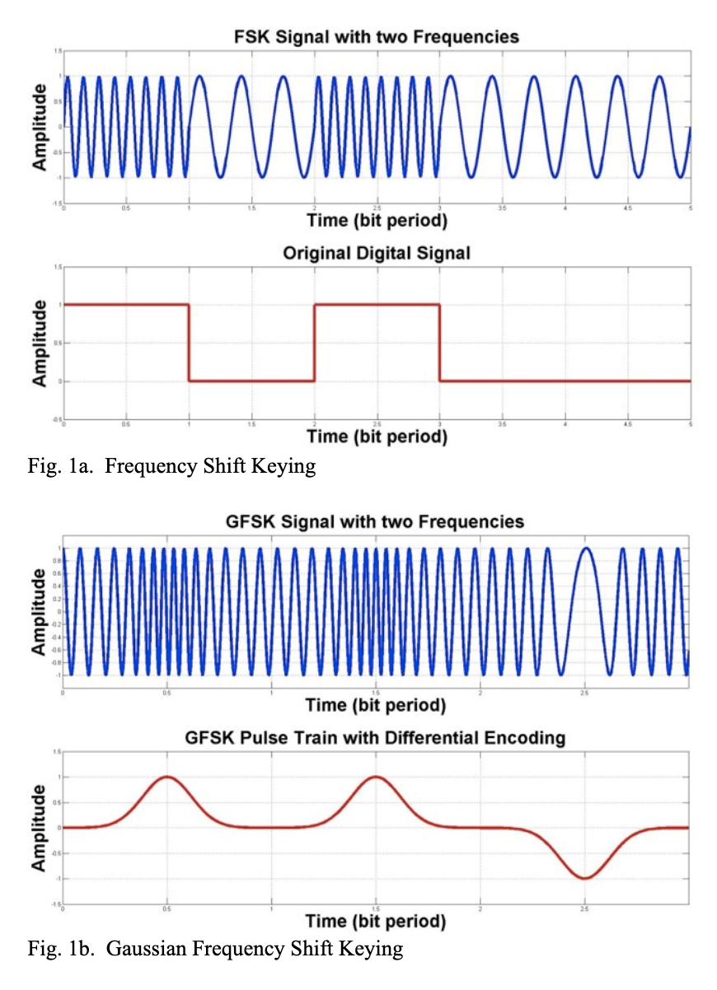
BLE modulation
Gaussian Frequency-Shift Keying (GFSK)
Improvement on base Frequency-shift Keying
Smoother transitions between bits -> reduces nearby interference

Slide 8
Why use GFSK?
Gaussian FSK lessens spectral leakage at the expense of some loss in intersymbol discriminability
Translation: GFSK reduces bandwidth at the cost of bit errors
Notes:
Images from http://j3.rf-explorer.com/40-rfe/article/53-tutorial-how-to-use-rf-explorer-to-monitor-a-rfbee?start=4

Slide 9
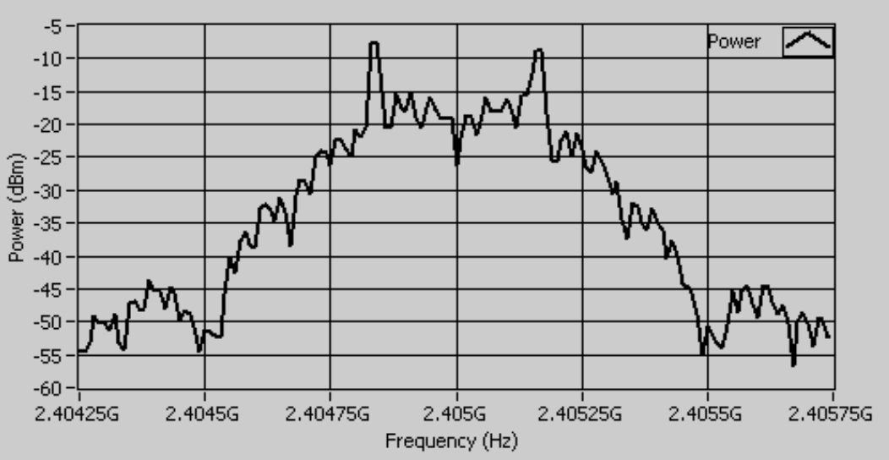
An example from `good case` BLE hardware
Notes:
Fig 8 in https://download.ni.com/evaluation/rf/intro_to_bluetooth_test.pdf

Slide 10
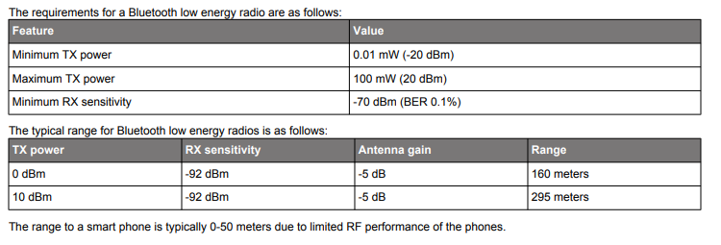
BLE signal strength
Remember nRF52840 capabilities
Transmit: up to 8 dBm
Receive sensitivity: -95 dBm

Slide 11
Outline
BLE Layers
Physical Layer
Link Layer
BLE roles
Advertising
Scanning
Communicating with advertisements
Advertisement Use Cases
Energy Use
Packet Collisions
Scan Responses

Slide 12
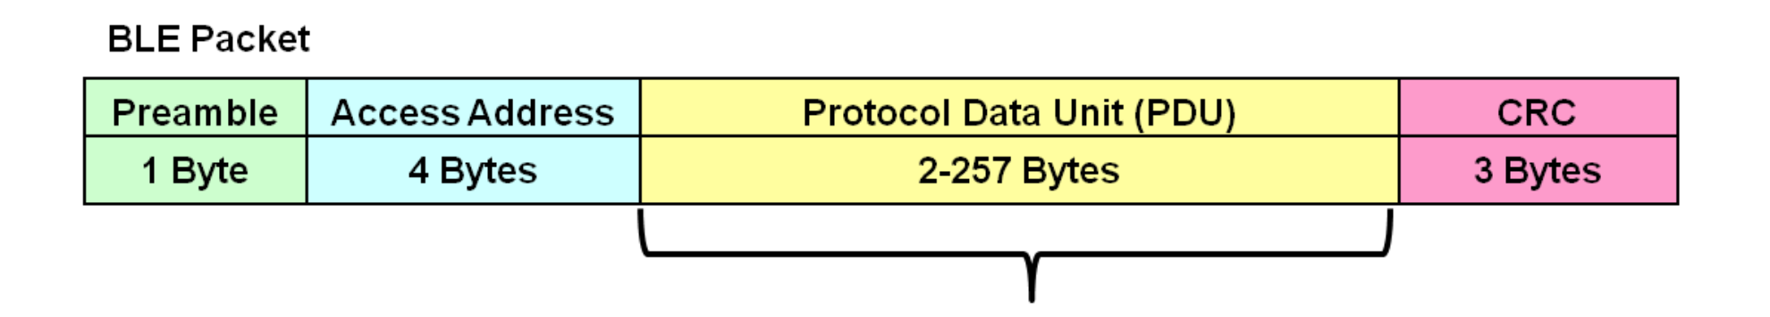
Packet structure
Same packet structure for both advertisements and connections
Fields are filled in little endian (the opposite of network byte order 😡)
Access address unique for each connection (randomly chosen)
In Advertising always set to 0x8E89BED6
Data

Slide 13
Device addresses
Public and private address forms
Public
48 bits: 24-bits of company ID, 24-bits of company assigned number
Literally the same MAC address scheme as Ethernet and WiFi
Private
Top two MSbs specify type
46 bits of random
46 bits of hash of an identity key
Why have the two types?

Slide 14
Device addresses
Public and private address forms
Public
48 bits: 24-bits of company ID, 24-bits of company assigned number
Literally the same MAC address scheme as Ethernet and WiFi
Private
Top two MSbs specify type
46 bits of random
46 bits of hash of an identity key
Why have the two types? Privacy

Slide 15
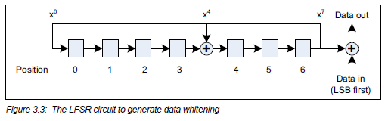
Data whitening
Avoid long series of repetitive bits (all zeros or all ones)
Would cause RF noise to be more focused in one direction
Radio hardware desires output to have zero DC-bias (or close to that)
Great example of the PHY and MAC being interwoven in wireless
I always forget this exists, since hardware usually handles it automatically

Slide 16
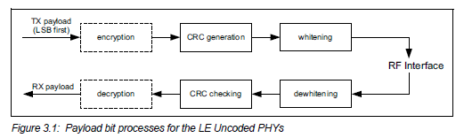
Bit processing pipeline

Slide 17
Break + Question
With enough scanners, could you track BLE devices as they move?

Slide 18
Break + Question
With enough scanners, could you track BLE devices as they move?
Link Layer
Depends on how long they use a device address for
You can do a scan of BLE transmissions to find device addresses
Scans at multiple locations can detect when a device moves throughout an area
But if the device re-randomizes between two scanners, you can’t follow it anymore
Re-randomizing at a scanner could be detectable…
Or if the user has more than one device with unsynchronized rotation schedules

Slide 19
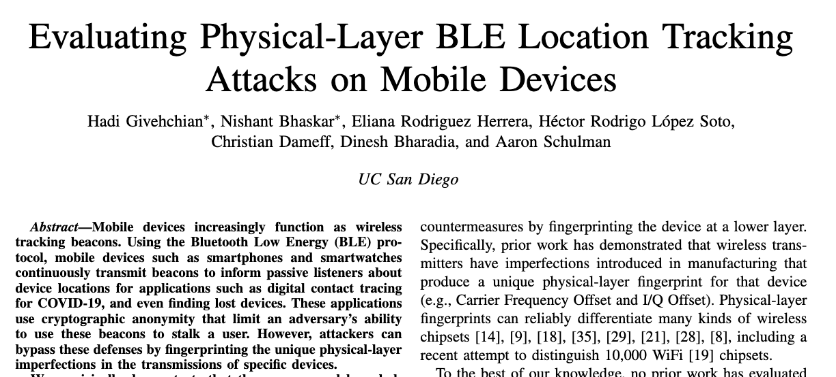
Break + Question
With enough scanners, could you track BLE devices as they move?
Physical Layer
Fingerprint unique physical-layer imperfections in signals
Looking at things like amplitude and timing
2022 paper out of UCSD explores this

Slide 20
Outline
BLE Layers
Physical Layer
Link Layer
BLE roles
Advertising
Scanning
Communicating with advertisements
Advertisement Use Cases
Energy Use
Packet Collisions
Scan Responses

Slide 21
BLE network topology
Peripheral
Connection
Central & Scanner
Scanner
Connection
Peripheral
Advertisement
Advertisement
Advertisement
Advertisement
Advertiser
Advertiser
Advertiser

Slide 22
Advertising
BLE discovery mechanism
Make nearby devices aware of advertiser’s existence
Communicate some information from or about advertiser
Traditional purpose is to enable connections, but this is also useful for general communication
Advertisements
Periodic broadcast messages with data
Scan Requests/Responses
Scanner sends responses after getting a request
Only occurs when scanner is listening
Almost literally “bonus advertisement data”

Slide 23
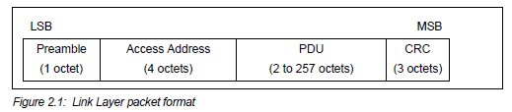
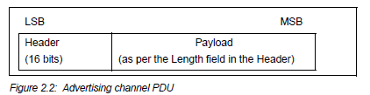
Advertising packet layering

Slide 24
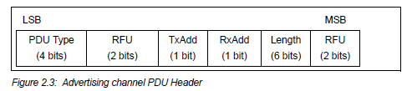
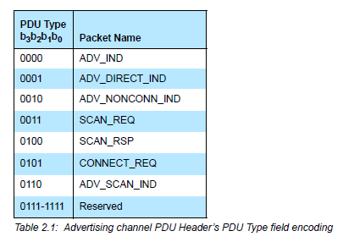
BLE advertising header
ADV_IND
Advertisement
Allows connections and scan requests
ADV_NONCONN_IND
Advertisement
No connections or scan requests
ADV_SCAN_IND
Advertisement
No connections but allows scan requests
SCAN_REQ
Scan request
SCAN_RSP
Scan response

Slide 25
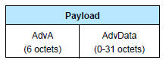
Advertisement payloads
AdvA – address of the advertiser
TxAdd bit from header specifies if this is a “public” or “random” address
Remaining up to 31 bytes are available for use
Putting it all together, up to 47 bytes total:
BLE Packet
Advertising PDU
Preamble 1 Byte | Access Address 4 Bytes | Header 2 Bytes | Advertiser Address 6 Bytes | Advertiser Data (Payload) 0-31 Bytes | CRC 3 Bytes

Slide 26
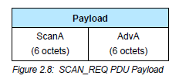
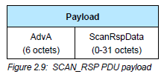
Scan Requests and Responses
Scan request
Request for additional information
Just the two addresses: the scanner’s and the advertiser’s
Scan response
Identical to an advertisement in structure but only occurs after a request
Usually has additional data not in the advertisement

Slide 27
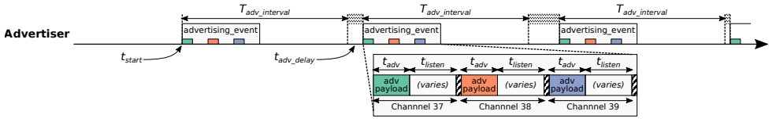
Advertising timing
Advertising Events occur periodically [20ms – 10.24 s] (or longer)
Plus a random delay after each instance [0-10ms]
Why?
User picks the rate as a tradeoff of energy and discovery latency

Slide 28
Advertising timing
Advertising Events occur periodically [20ms – 10.24 s] (or longer)
Plus a random delay after each instance [0-10ms]
Why? Avoid repeat collisions
User picks the rate as a tradeoff of energy and discovery latency

Slide 29
Advertising event
Three transmissions, one on each advertising channel
Always in the same order
Transmission, followed by listening window on that same channel
Requests will be sent >=150 us (Inter-Frame Spacing, IFS) after Tx
Followed by a retune to the next channel frequency
This short listen window is the magic “low energy” part

Slide 30
Preserving energy in communication
Most energy is spent listening
This is due primarily to how long listening durations are compared to transmissions
Example: maximum-sized BLE transmission:
8 bits/byte * 47 bytes = 376 bits at 1 Mbps = 0.376 ms transmitting
So listening for an entire second is >2500 times longer

Slide 31
Payload of an advertisement
What do you stick in the BLE payload anyways?
Theoretically whatever you want, but that isn’t very compatible
Point is to specify capabilities of the advertiser
Desire: specify payloads in such a way that all scanners can interpret what they mean about the device
This is different from traditional internet packets
Broadcasts are for _anyone_ to hear, not a specific server/application
Which fields are or aren’t present is device-specific
A lot more possible fields than will really be used on any device

Slide 32
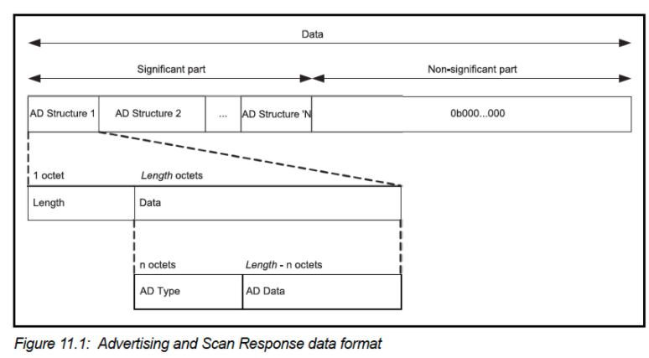
TLV Format
Type – Length – Value (Wikipedia)
Actually, BLE does the length part first
Scanner can hop through length/type pairs to find what interests it

Slide 33
Payload types
Listed in the Core Specification Supplement [Supplement v9]
Each might have their own considerations about AD Data format
Flags (supported modes: BLE and Bluetooth) required by Apple?
Name
Service UUID
TX Power Level
Manufacturer-specific data
And about twenty others

Slide 34
Outline
BLE Layers
Physical Layer
Link Layer
BLE roles
Advertising
Scanning
Communicating with advertisements
Advertisement Use Cases
Energy Use
Packet Collisions
Scan Responses

Slide 35
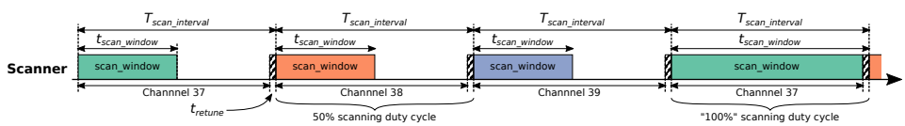
Scanning Pattern
Iterate through channels, listening for advertisements
T_{scan_interval} controls rate at which channels are changes
T_{scan_window} controls duty cycle of listening
Why listen at a low duty cycle?

Slide 36
Scanning Pattern
Iterate through channels, listening for advertisements
T_{scan_interval} controls rate at which channels are changes
T_{scan_window} controls duty cycle of listening
Why listen at a low duty cycle? Save energy

Slide 37
A warning about scanning expectations
Scanners will NOT receive 100% of packets sent
Even ignoring range issues
Packets are lost due to (in roughly descending order):
Duty cycle
Sharing 2.4 GHz antenna with WiFi
Retune period after each scanning interval
Dropped packets in the receive software
Packet collisions

Slide 38
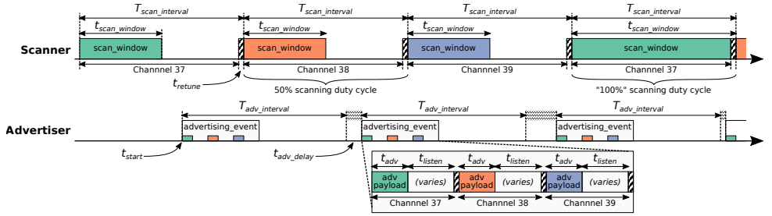
Break + Putting it all together
Advertisements are received when the channel of the scan window and the channel of the advertisement overlap in time (and space)

Slide 39
Outline
BLE Layers
Physical Layer
Link Layer
BLE roles
Advertising
Scanning
Communicating with advertisements
Advertisement Use Cases
Energy Use
Packet Collisions
Scan Responses

Slide 40
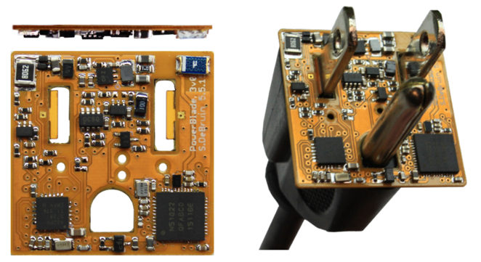
Advertisements are sufficient for some applications
BLE advertisements are uncoordinated, broadcast messages designed for discovery.
Devices are being deployed using advertisements.
Beacons – iBeacon
Tracking – Tile
Local communication – Apple Continuity
Sensor deployments – PowerBlade
Notes:
PowerBlade is a great example of this.
It’s a plug-load power meter
Initially configured to use advertisements as a simple method for reading measurements with a smartphone
We are interested in household deployments where dozens of PowerBlades will be deployed to measure all the loads in a home
Can we still use BLE advertisements for data transfer in the presence of many other devices?

Slide 41
Beacons
Advertising with advertisements!
Web of Things
Real-world tags that broadcast virtual-world identifiers
iBeacon and Eddystone
Formats for sending URLs and device identifiers
Use existing BLE fields (Service Data and Manufacturer-Specific Data)

Slide 42
Tracking
Find devices nearby
Get a sense of distance to the device
Find my X
Tile: find my keys
Apple: find my device (before UWB radios)
Uses TX power level field
Lists the transmitted power of the device
Pathloss = TX power – RSSI (all in dBm)

Slide 43
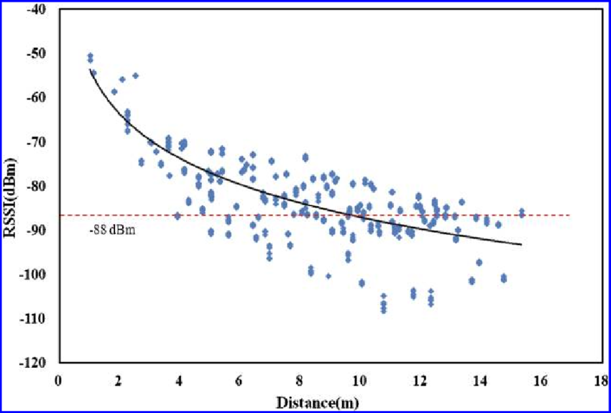
Problem with RSSI-based distance – not accurate
Pathloss is NOT only due to distance
RSSI is way worse at this than you hope it would be
Citation: literally everyone has made this figure at some point

Slide 44
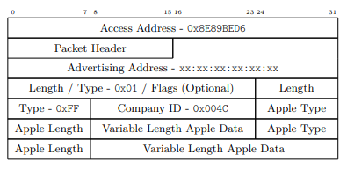
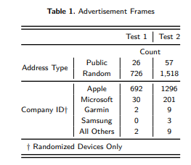
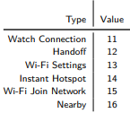
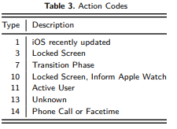
Local communication: Apple Continuity
Communication with only nearby devices
Apple Continuity
Martin, Jeremy, et al. "Handoff all your privacy–a review of apple’s bluetooth low energy continuity protocol." Proceedings on Privacy Enhancing Technologies 2019.4 (2019): 34-53.

Slide 45
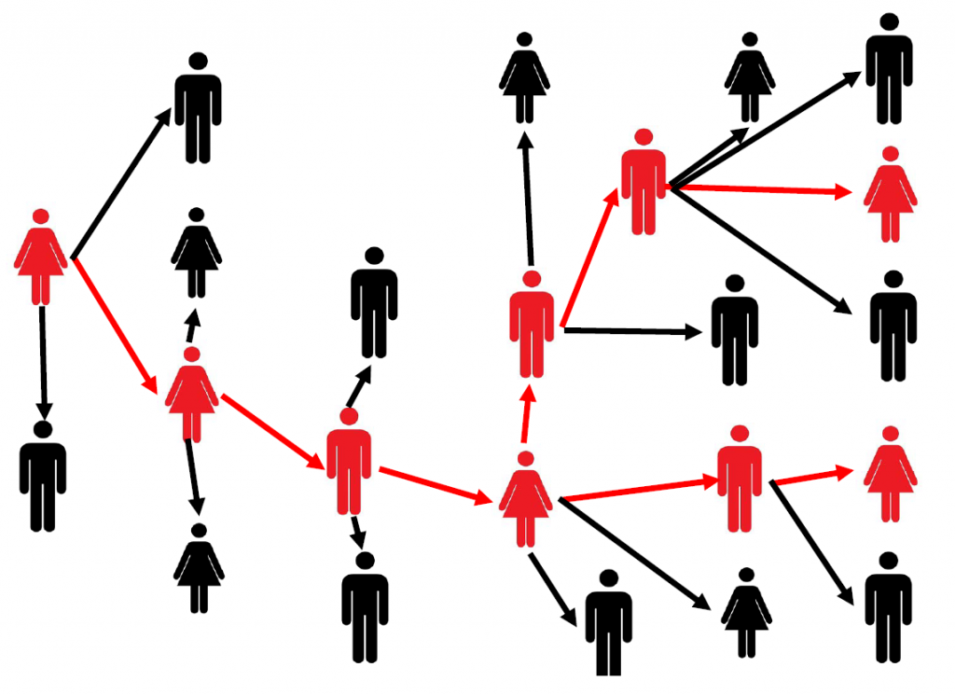
Local Communication: Exposure Notifications
Apple and Google collaboration to use phones for contact tracing
Smartphone constantly broadcasts identifier.
Periodically, each smartphone listens for broadcasts around it.
Check list of identifiers to see if you’ve been around someone who is sick.
Requires government/healthcare system interactions to determine when an identifier should be flagged as sick
24 states (not Illinois) adopted this
Implemented at OS level in background

Slide 46
Sensor deployments
Report data so gateways and users can retrieve it simultaneously
Easy introspection during a deployment
Satisfy users’ curiosity
Ignore difficult questions about networking
Just broadcast the data!
DeBruin, Samuel, et al. "Powerblade: A low-profile, true-power, plug-through energy meter." Proceedings of the 13th ACM Conference on Embedded Networked Sensor Systems. 2015.

Slide 47
Outline
BLE Layers
Physical Layer
Link Layer
BLE roles
Advertising
Scanning
Communicating with advertisements
Advertisement Use Cases
Energy Use
Packet Collisions
Scan Responses

Slide 48
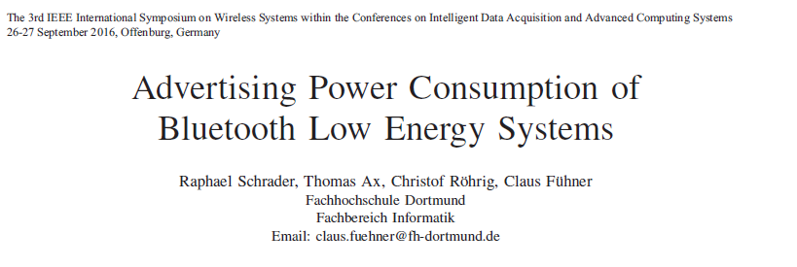
Paper: power measurements of BLE advertisements
Schrader, Raphael, et al. "Advertising power consumption of bluetooth low energy systems." 2016 3rd International Symposium on Wireless Systems within the Conferences on Intelligent Data Acquisition and Advanced Computing Systems (IDAACS-SWS). IEEE, 2016.

Slide 49
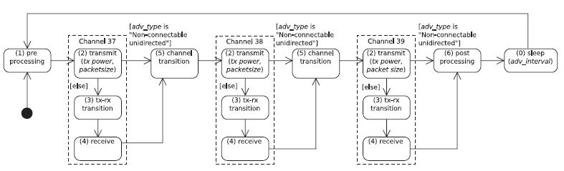
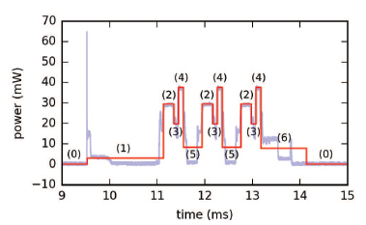
Energy model for BLE advertisements
Creates a set of states and metrics for how much power each uses and for what duration
power * duration = energy

Slide 50
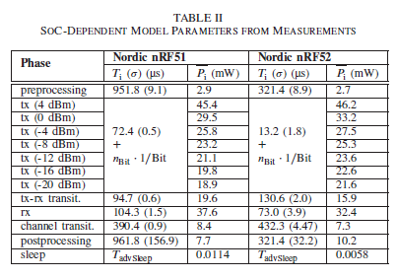
Measurements of Power Use
Power use and duration (energy)
nRF51 (nRF51822)
nRF52 (nRF52832)

Slide 51
How much energy does it cost to send data over advertisements?
Configuration
nRF51822 microcontroller
Maximum payload size
+4 dBm transmit power
Connectable advertisement
Sleep power 11 µW
One packet per second example:
110 µW average
~270 days on a CR2032
One packet per minute example:
13 µW average
~2250 days on a CR2032

Slide 52
Break + Open Question
How long does the lifetime of a BLE advertiser need to be?

Slide 53
Outline
BLE Layers
Physical Layer
Link Layer
BLE roles
Advertising
Scanning
Communicating with advertisements
Advertisement Use Cases
Energy Use
Packet Collisions
Scan Responses

Slide 54
Questions about network capability
What are the odds that a transmitted advertisement will be received?
Packet reception rate
If M redundant advertisements are sent instead, what are the odds that at least one are received?
Data reception rate
How do these odds vary with number of devices, advertising interval, and packet size?

Slide 55
What causes transmissions not to be received?
Not within range of the gateway.
Or various other losses within the gateway itself
Two devices try to send at the same time (packet collision).
X
X
broadcast domain

Slide 56
What is the probability of a packet collision?
time
t_{adv_0}
Packet 0
Jeon, Wha Sook, et al. "Performance analysis of neighbor discovery process in bluetooth low-energy networks." (IEEE Transactions on Vehicular Technology, 2016). Perez-Diaz de Cerio, David, et al. "Analytical and experimental performance evaluation of BLE neighbor discovery process including non-idealities of real chipsets." (Sensors, 2017).

Slide 57
What is the probability of a packet collision?
time
t_{adv_1}
t_{adv_0}
Packet 0
Packet 1
Packet 1
Packet 1
Packet 1
Packet 1
Jeon, Wha Sook, et al. "Performance analysis of neighbor discovery process in bluetooth low-energy networks." (IEEE Transactions on Vehicular Technology, 2016). Perez-Diaz de Cerio, David, et al. "Analytical and experimental performance evaluation of BLE neighbor discovery process including non-idealities of real chipsets." (Sensors, 2017).
Notes:
Collisions occur if any part of the two packets overlap
Particularly true for BLE that only has an 8-bit preamble

Slide 58
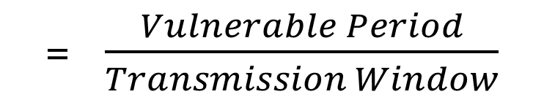
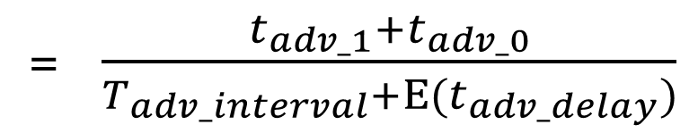
What is the probability of a packet collision?
time
t_{adv_1}
t_{adv_0}
Packet 0
Packet 1
Probability of Collision
= $\frac{Vulnerable Period}{Transmission Window}$
= $\frac{t_{adv_1}+t_{adv_0}}{T_{adv_interval}+Ε(t_{adv_delay})}$
Jeon, Wha Sook, et al. "Performance analysis of neighbor discovery process in bluetooth low-energy networks." (IEEE Transactions on Vehicular Technology, 2016). Perez-Diaz de Cerio, David, et al. "Analytical and experimental performance evaluation of BLE neighbor discovery process including non-idealities of real chipsets." (Sensors, 2017).
Notes:
The vulnerable period is the sum of the two advertisement durations
While the transmission window is the advertisement interval plus the expected value of the random delay

Slide 59
Determine Probability of Multiple Failures
Given:
Probability of Collision
Determine:
Probability of Reception for data sent redundantly across M packets
i.e., what are the odds that at least one of the packets doesn’t collide
1 – (Probability of Collision^{M})
(P_{c})^{M} = Probability that all of them collide
1-that = Probability that NOT all of them collide

Slide 60
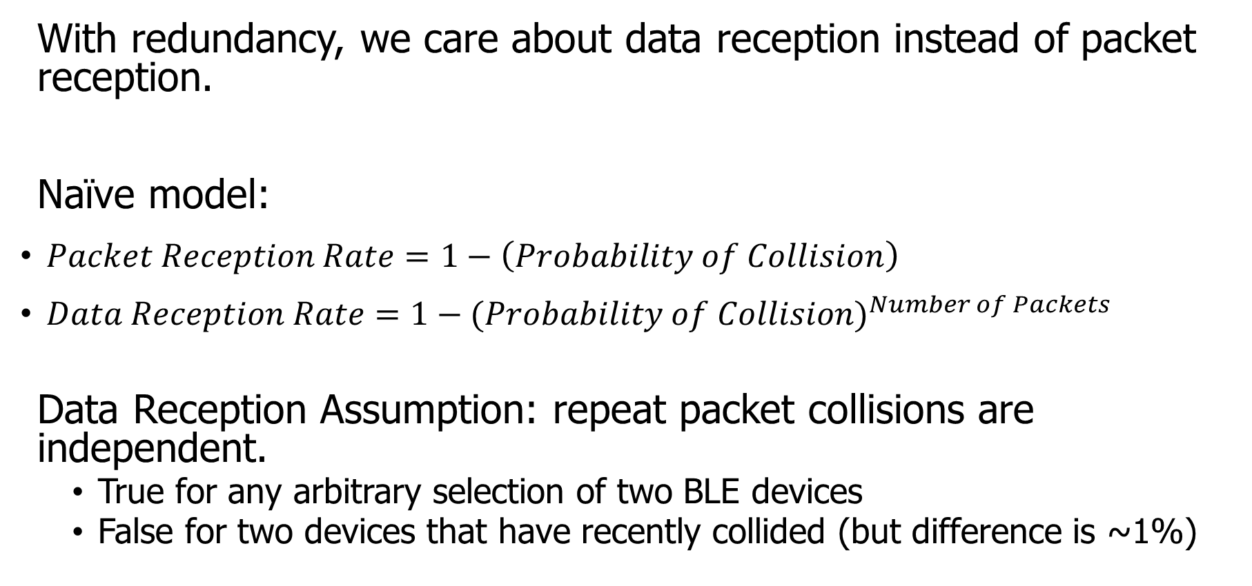
How do we determine reception rate?
With redundancy, we care about data reception instead of packet reception.
Naïve model:
$Packet Reception Rate=1−\left(Probability of Collision\right)$
$Data Reception Rate=1−{(Probability of Collision)}^{Number of Packets}$
Data Reception Assumption: repeat packet collisions are independent.
True for any arbitrary selection of two BLE devices
False for two devices that have recently collided (but difference is ~1%)
Notes:
Earlier we demonstrated the probability of collision, which can be used to determine packet reception rates.
Now with redundancy, we don’t care about the reception of any one packet, but the reception rate of the data that is being sent over them.
Naively, we can take the probability of collision and repeat it for any number of redundant packets.
There is an assumption in that model that repeat collisions are independent, which I’ll show you is false.

Slide 61
When are transmissions from two devices independent?
Assumption is true for any BLE device that has been advertising for some time
Sum of random delays grows the uncertainty of transmission.
Applied to periodic transmissions, any point in interval becomes equally likely.
Range of 1x delay, 2x delay, 3x delay, until it wraps
time
T_{adv_interval}
delay
T_{adv_interval}
delay
T_{adv_interval}
delay

Slide 62
When are transmissions from two devices NOT independent?
Independence assumption is false for two BLE devices that have recently collided.
If T_{adv_interval} is identical, next transmissions with be close in time.
Collision is determined by difference of random delays.
Further repeat collisions have the same probability of occurrence.
New time period collisions could occur within
time
T_{adv_interval}
delay
Notes:
If two devices have collided before, and have the same interval, at the next period they will certainly collide again.
BLE has a random delay appended to reduce this possibility.
But we’ve now greatly reduced the transmission window that the a collision could occur in. We can calculate this to determine a distinct probability of repeat collision.
Note that further repeat collisions are bounded by the same difference of random delays, and therefore have the probability of a second repeat collision is the same as the probability of a first repeat collision.

Slide 63
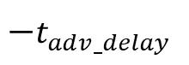
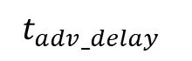

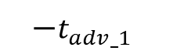

Calculating probability of a repeat collision
Difference of two uniform random delays forms a triangular distribution
probability
t_{adv_1}
t_{adv_0}
Probability of Repeat Collision
difference in transmission time
$$−t_{adv_delay}$$
$$−t_{adv_1}$$
$$0$$
$$t_{adv_0}$$
$$t_{adv_delay}$$

Slide 64
Important lesson: spend time on things that are important
How important was accounting for repeat collisions?
Maximum error is about a 1% change in Data Reception Rate.
This is due to size of delay 10 ms compared to size of transmission ~300 µs.
200 ms interval advertisements

Slide 65
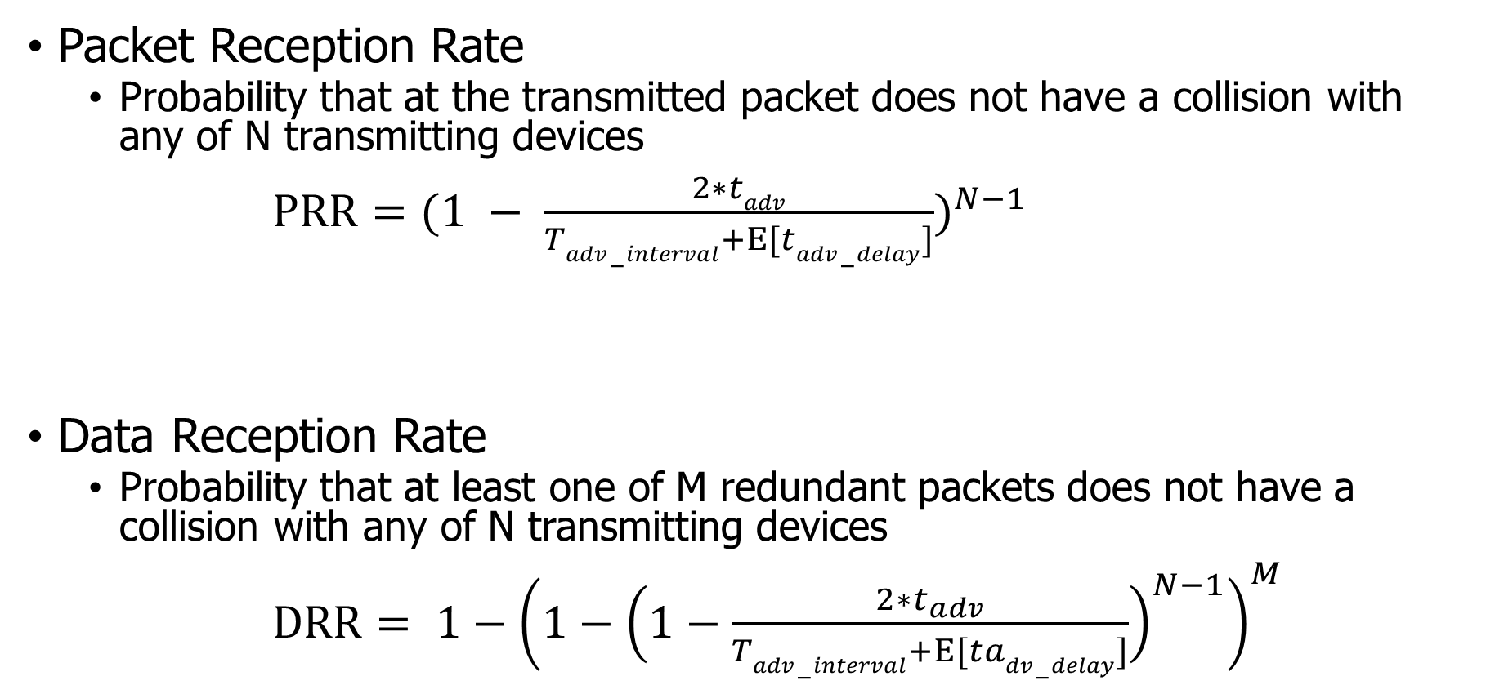
Equations for modeling data transmissions
Packet Reception Rate
Probability that at the transmitted packet does not have a collision with any of N transmitting devices
$PRR={(1 − \frac{2∗tadv}{Tadv−interval+Ε[tadv−delay]})}^{N−1}$
Data Reception Rate
Probability that at least one of M redundant packets does not have a collision with any of N transmitting devices
$DRR= {1−\left(1−{\left(1−\frac{2∗t_{adv}}{Tadv−interval+Ε[tadv−delay]}\right)}^{N−1}\right)}^{M}$

Slide 66
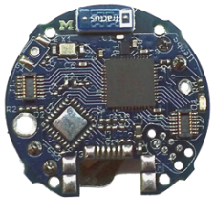
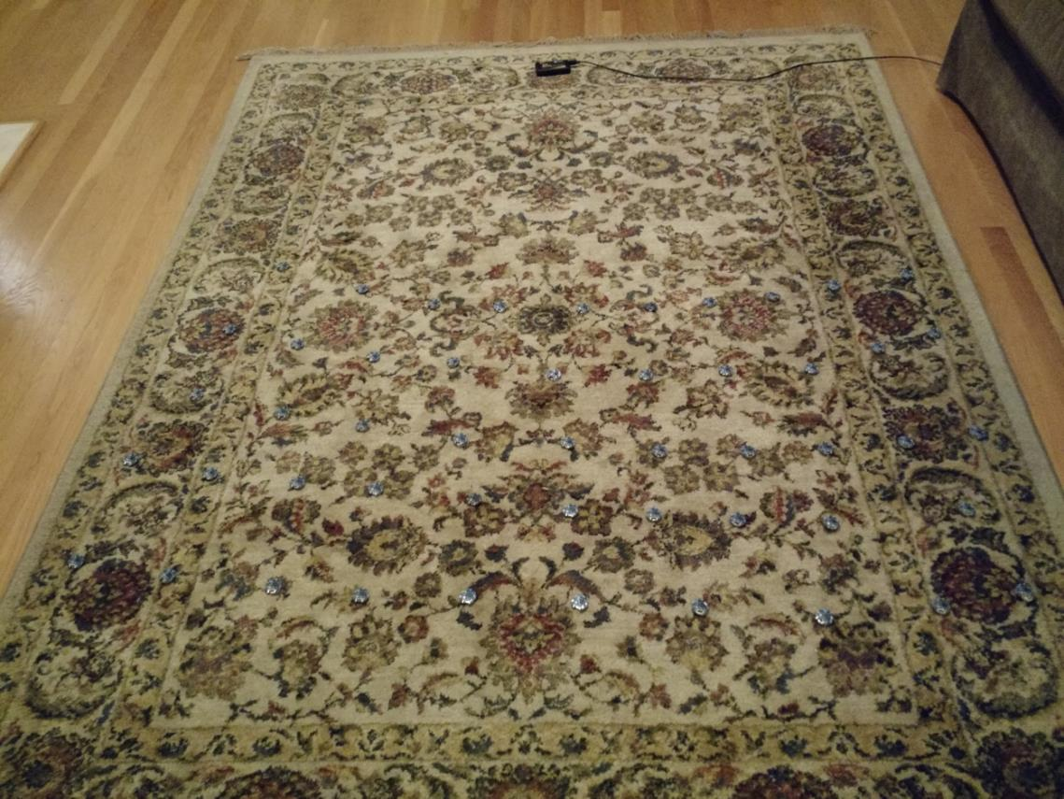
Is the model valid?
Empirical testing setup:
50 devices
1 meter from scanner
5-10 cm apart
Transmit monotonically increasing sequence numbers.
Sweep number of devices and advertising intervals.

Slide 67
Redundancy results in high DRR even with many devices.
In this example, a sensor has new data once per second and sends it in 1-3 packets.
Even without redundancy, data reception rates never fall below 87% even with 200 devices in a deployment, assuming no interference.

Slide 68
Redundancy is (normally) better than less congestion.
Design question:
Send more packets to gain from redundancy? OR
Send less packets to reduce congestion?
The answer changes, but only with many devices.
Notes:
This plot changes with advertisement rate, and can get as low as 100 devices

Slide 69
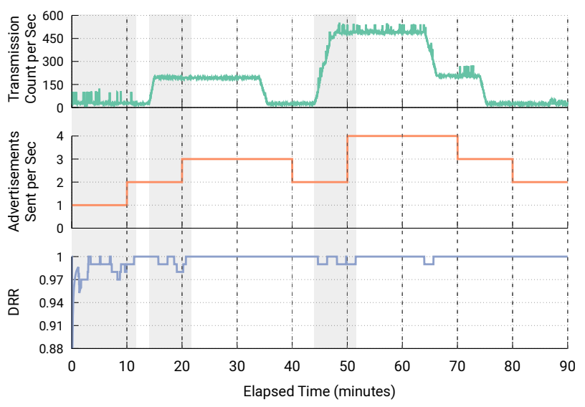
Automatic adaptation to advertising environment
Devices could automatically adjust to the environment for best transmission rate
Scan and count how many unique devices are seen
Estimate DRR based on that traffic environment for redundancy from 1-10 packets per second
Choose the optimal result

Slide 70
Outline
BLE Layers
Physical Layer
Link Layer
BLE roles
Advertising
Scanning
Communicating with advertisements
Advertisement Use Cases
Energy Use
Packet Collisions
Scan Responses

Slide 71
Scan requests/responses seem intriguing
Why not send most data in scan responses instead of advertisements?
Theoretically could reduce energy costs
Scan we use scan requests as a form of acknowledgement?
Could relieve need for redundant transmissions
Problem: scan requests/responses don’t work all that well

Slide 72
Scan Requests and Responses are broken
Goal: provide a little extra advertisement data on demand
Problem: exponential backoff for lost messages
If there is a request without a response, scanners assume collision with another scanner and exponentially back off from requesting
But collisions are far more likely between a device and a scanner, which should not have back off
Result is that scan requests will occur far less frequently than expected
Instead, just send additional advertisements with different data
Kravets, Robin, Albert F. Harris III, and Roy Want. "Beacon trains: blazing a trail through dense BLE environments." Proceedings of the Eleventh ACM Workshop on Challenged Networks. 2016.

Slide 73
Outline
BLE Layers
Physical Layer
Link Layer
BLE roles
Advertising
Scanning
Communicating with advertisements
Advertisement Use Cases
Energy Use
Packet Collisions
Scan Responses

